Slide 1



Airborne Contaminants from Mining Operations In Arizona
Presenter: Jeremy Elias
A.E. Sáez, E.A.Betterton, K. Rine
University of Arizona Space Grant Symposium
Arizona State University, Tempe, AZ

Slide 2
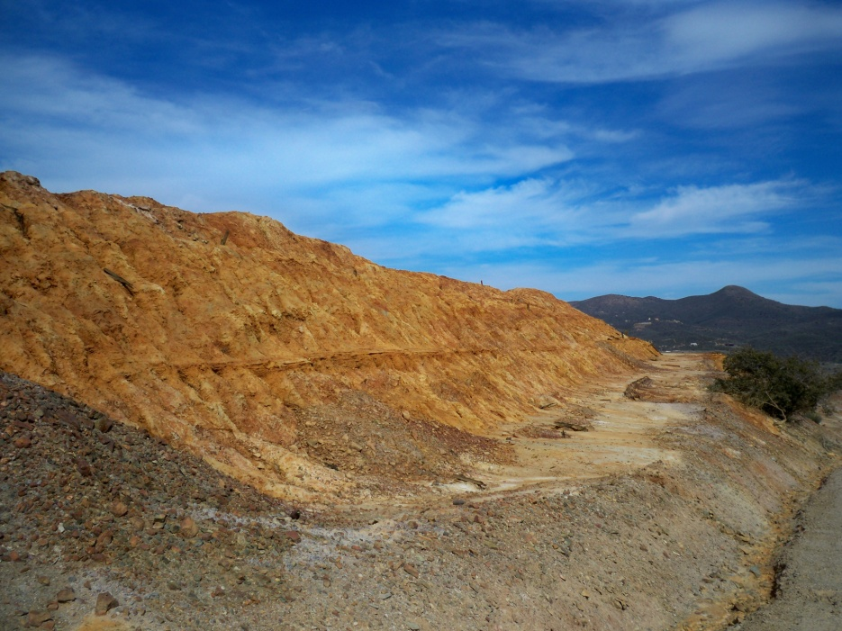
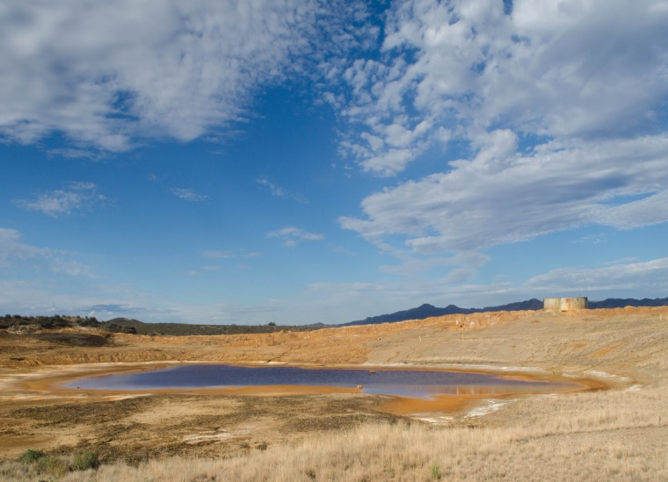
Monitoring Windblown Dust
Mine tailings
Prone to wind erosion in dry/arid climates
Monitoring the transport of dust allows us to determine environmental impact

Slide 3
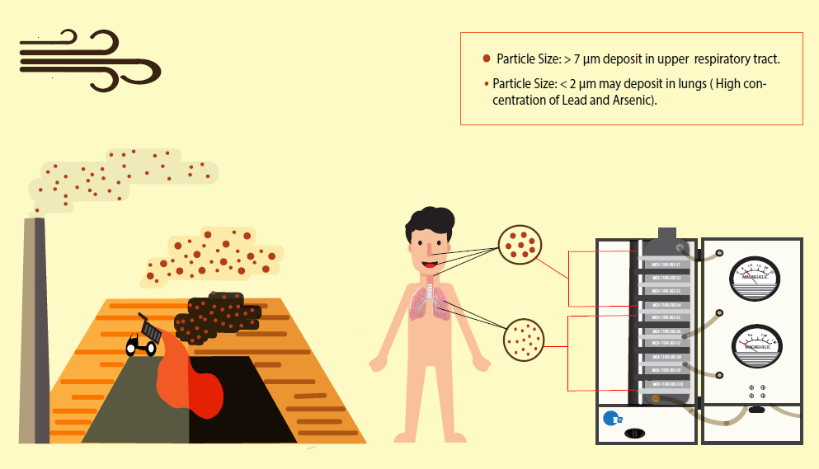
Significance
Airborne toxic contaminants
Image By: Tania Rodriguez
Notes:
Coarse particles- swallowed, small particles- inhaled, can go through bloodstream

Slide 4
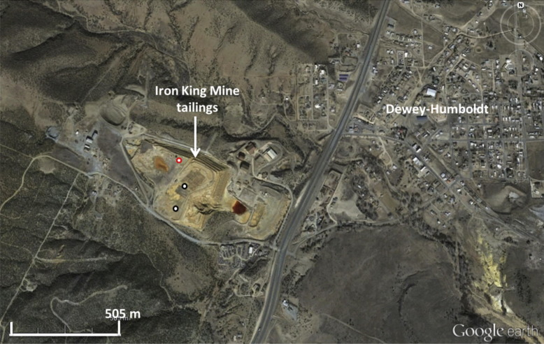
Field Sites in Arizona
Iron King Mine Site
  Next to town of Dewey-Humboldt, AZ
  Peak Arsenic (As) concentration: 6300 mg/kg
  Peak Lead (Pb) concentration: 9830 mg/kg
Visual satellite image of the Iron King Mine tailings and surrounding area
Notes:
1:1 mg/kg:ppm
6300 mg/kg-
9830 mg/kg-EPA lead soil level: 1200

Slide 5
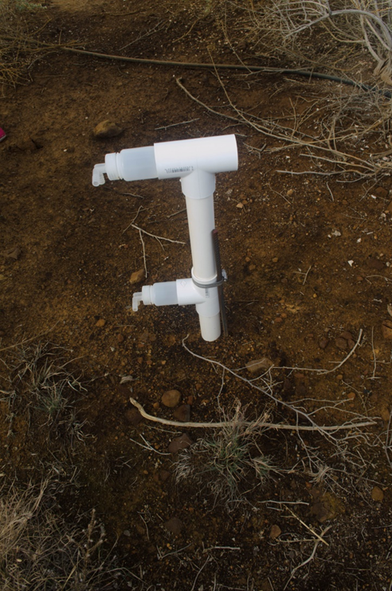
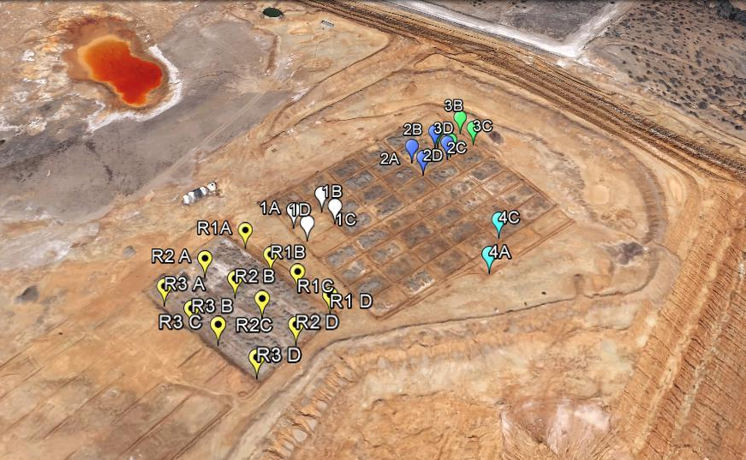
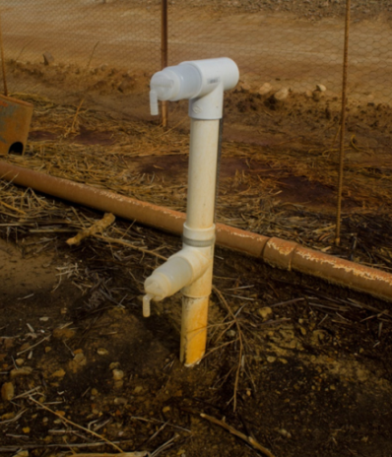
Measuring Windblown Dust
Collecting windblown dust across vegetation plots
Wilson and Cooke Samplers
  Commonly used for measuring material transported by wind

Slide 6
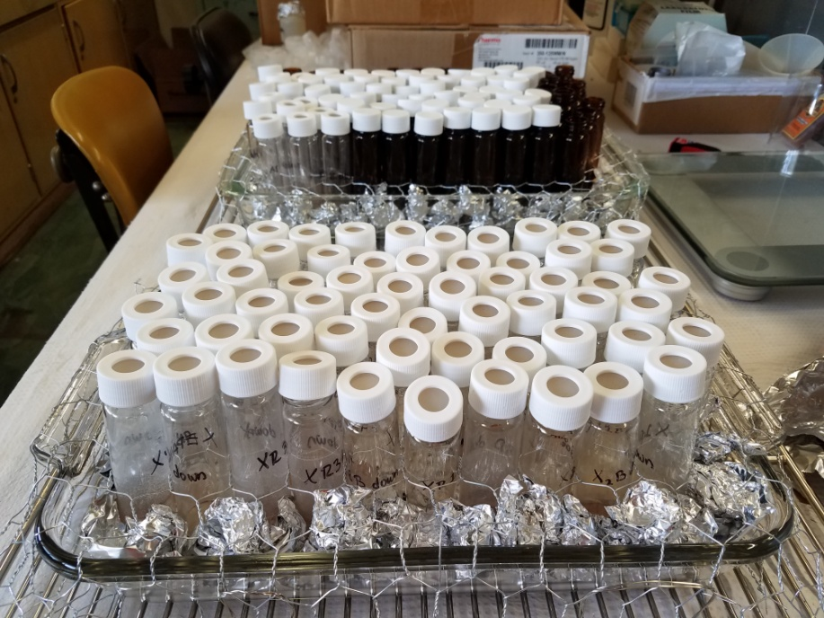
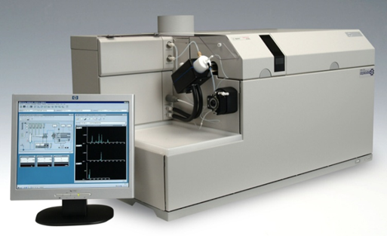
Data Analysis
Mass Analysis
Inductively Coupled Plasma Mass Spectrometry (ICP-MS)
  Elements Analyzed: V, Cr, Cr, Fe, Co, As, Se, Be, Al, Mn, Ni, Cu, Zn, Mo, Ag, Cd, Sn, Sb, Ba, Pb

Slide 7
Wilson & Cooke Results
Notes:
Wind from the south/southwest

Slide 8
Initial Samples
Final Samples
Notes:
Initial Set: 8/18/16-10/28/16
Final Set: 10/28/16-1/18/17

Slide 9
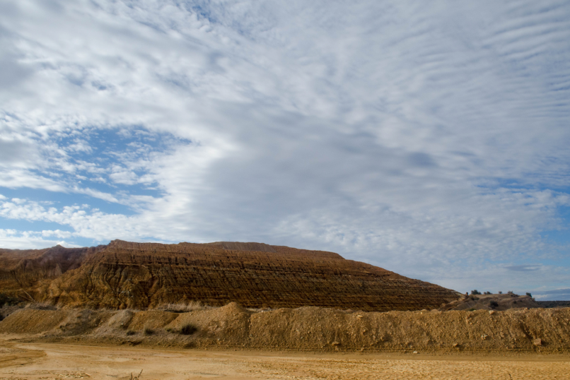
Conclusions
Vegetation at the edge of the tailings does have the ability to reduce wind transport of dust on the surface.
These results can inform future mine reclamation efforts.
Future Work: analyzing metal content using ICP-MS

Slide 10
Thank You

